Slide 1
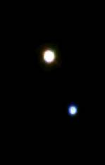
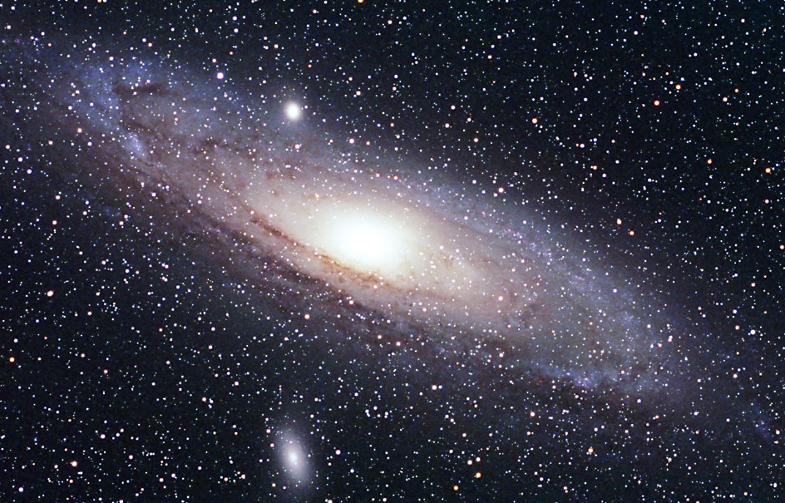
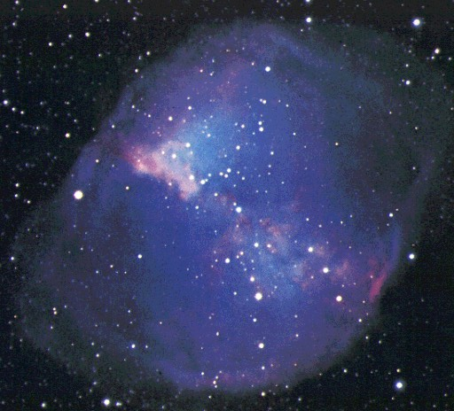
Exploring the Milky Way
h & Chi Persei

Slide 2
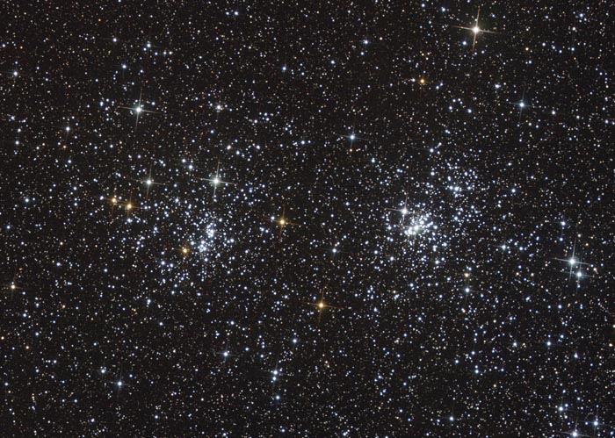
h & χ Persei Through the Telescope

Slide 3
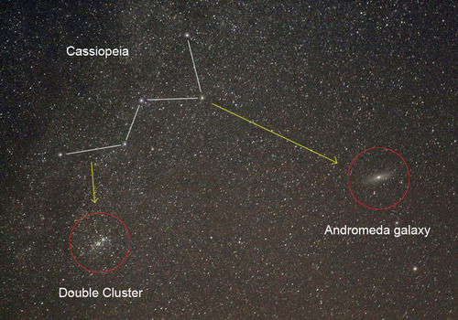
h & χ Persei in the Night Sky
h and chi (χ) Persei can be found near the “W” of Cassiopeia.

Slide 4
What are h & χ Persei?
h and chi (χ) Persei are a pair of open star clusters. They are several hundred light years apart but they look close together because they are in the same direction when seen from Earth.

Slide 5
What is an Open Cluster?
An open cluster is a group of young stars, that have all “recently” formed from a large cloud of interstellar gas called a nebula.
Open clusters typically contain a few hundred to a few thousand stars.

Slide 6
How far away are h & χ Persei?
It takes over 7,000 years for light to travel from the double cluster to Earth.

Slide 7
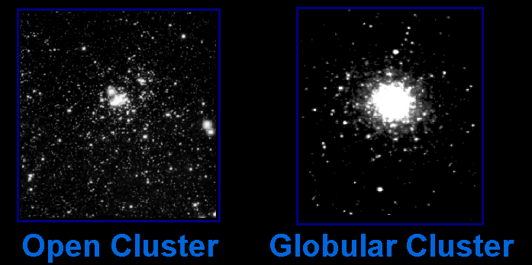
Star Clusters 101
There are two main types of star clusters in our galaxy …

Slide 8
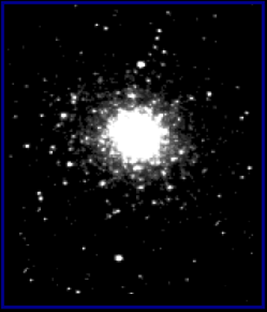

Open and Globular Star Clusters Are Different Sizes
Open Cluster
Globular Cluster
are about 30 light years across.
are about 150 light years across.
Open clusters are 5 times smaller than globular clusters. They may look the same size if the open cluster is closer.

Slide 9
Open and Globular Star Clusters Are Different Sizes
Open Cluster
Globular Cluster
have hundreds to thousands of stars.
have thousands to nearly a million stars.

Slide 10
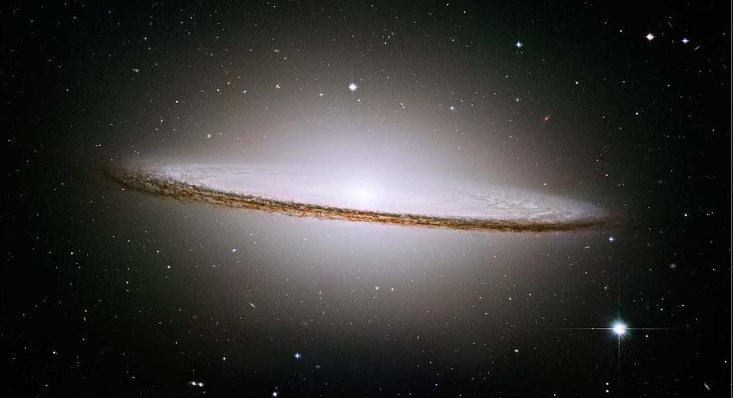
Star Clusters 101
Star Clusters 101
Open star clusters exist within the disc of the galaxy. Globular clusters exist above and below the plane of the galaxy.
globular clusters
open clusters
halo
Central bulge
disk
disk

Slide 11
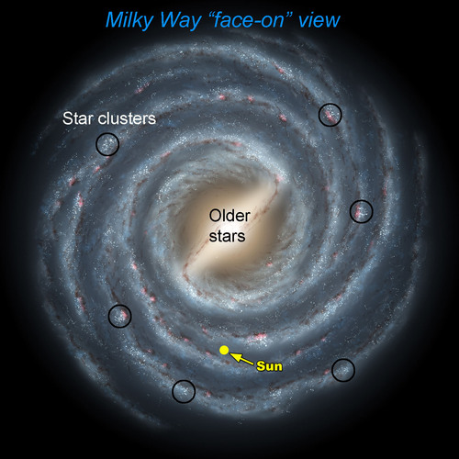
Star Clusters 101
Open clusters like h & Chi Persei are found in the spiral arms in the disk of spiral galaxies like ours.

Slide 12
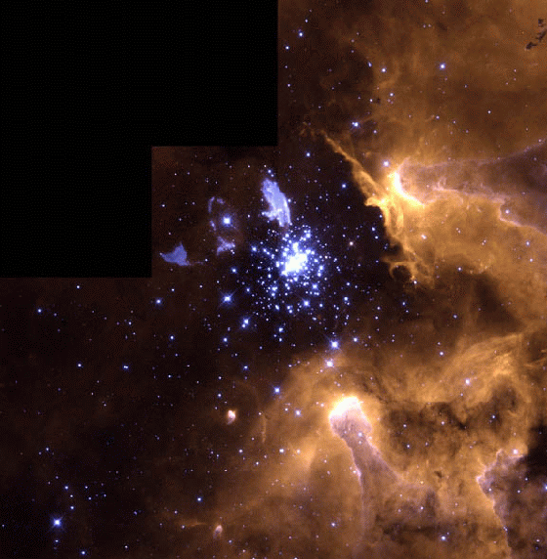
Open Clusters
of the Milky Way
The youngest of our galaxy’s open clusters are veiled in the dense clouds of gas and dust from which they are forming. Some of the stars in these clusters may still be forming.

Slide 13
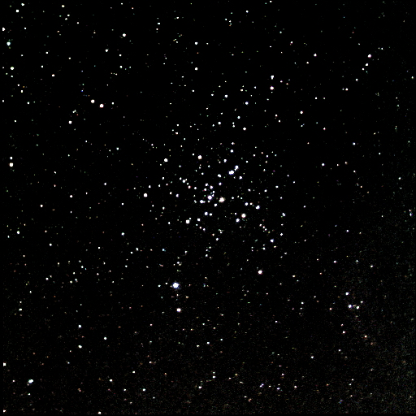
Open Clusters
of the Milky Way
“Mature” open star clusters have used up all of their gas forming new stars. For a few million years the stars of the cluster will lie together in space.

Slide 14
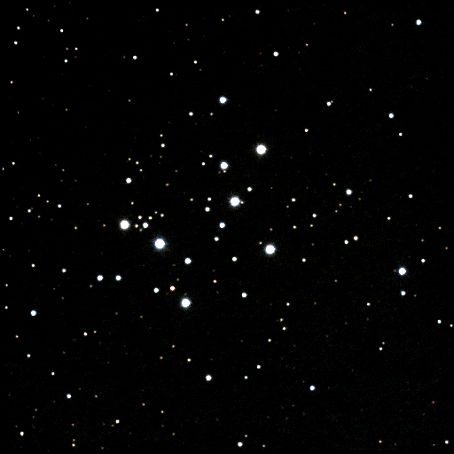
Open Clusters of the Milky Way
Because the stars are only weakly held together by their mutual gravity, they eventually begin to drift apart.
This is a smattering of stars that once was an open cluster.

Slide 15
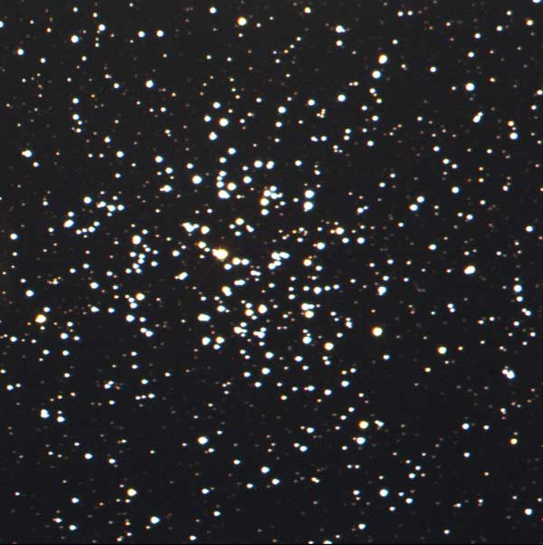
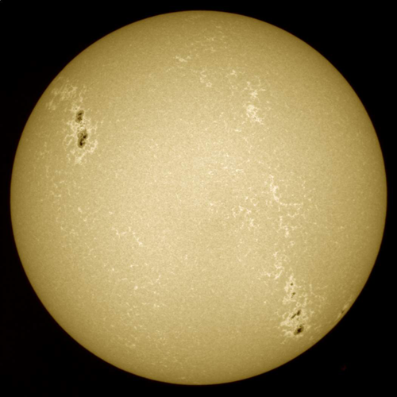
Open Clusters Destiny
Our Sun originated in an open cluster similar to this one about 5 billion years ago.

